Slide 1

CEIS150
FEB-2023
Nirja Patel

Slide 2
Project - 1
Software Environment Setup

Slide 3
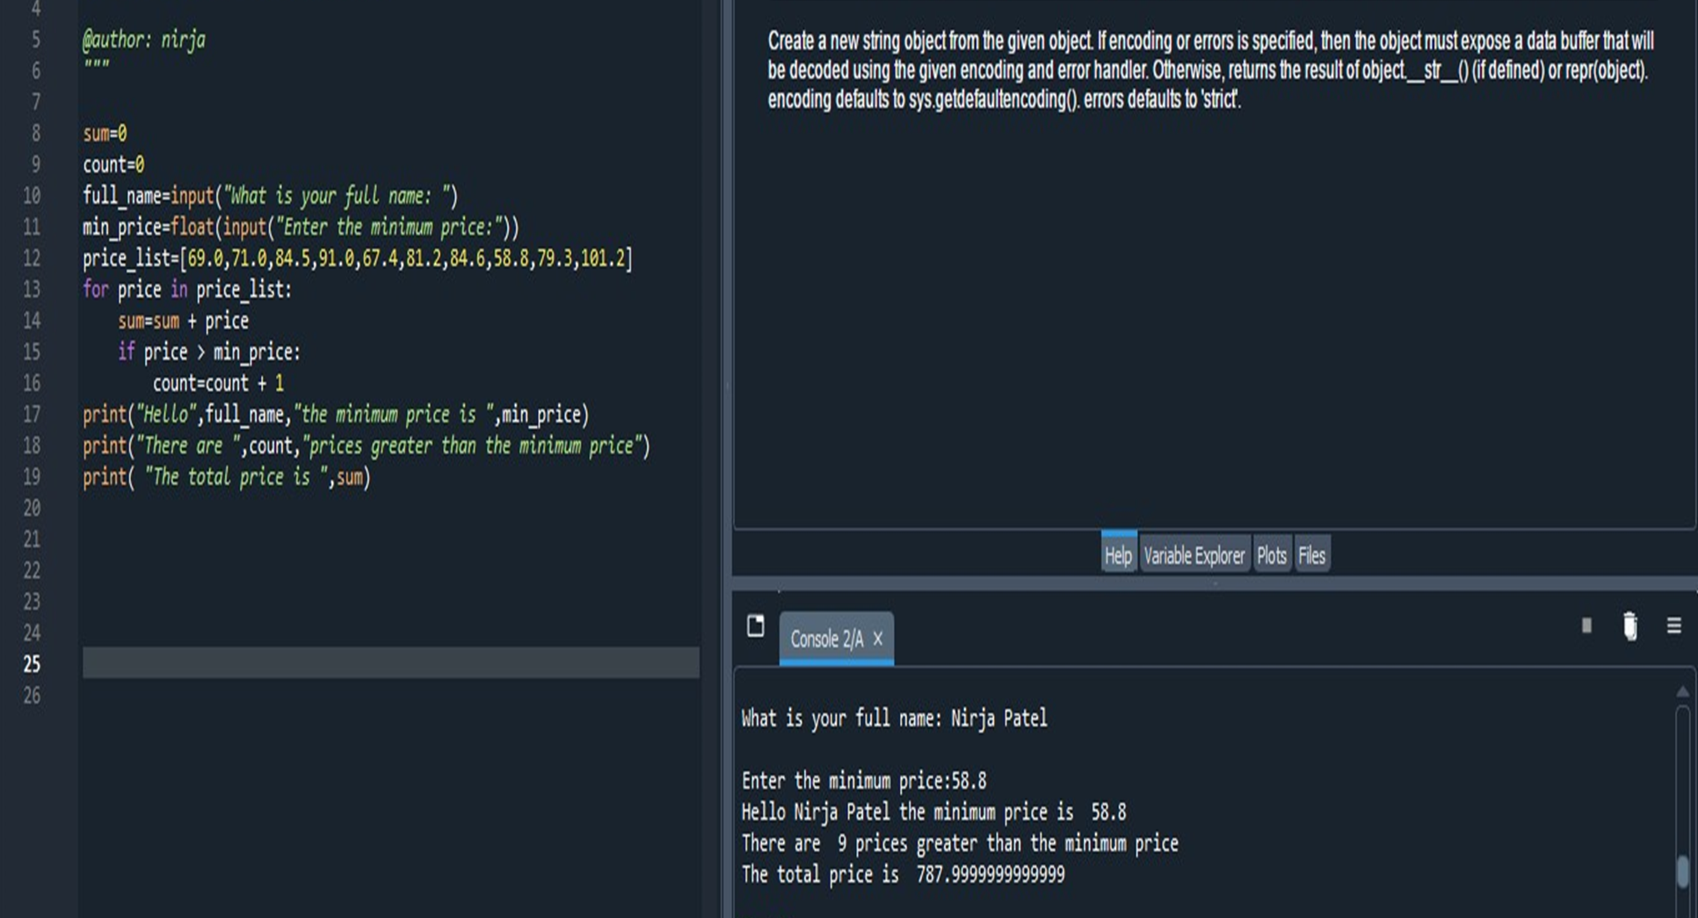
Successfully created a Python Program at Spyder (Python 3.9)

Slide 4
Project - 1i
PYTHON Stock Tracking Project

Slide 5
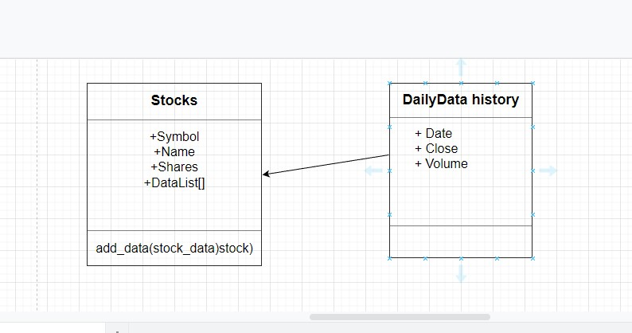
Class Diagram

Slide 6
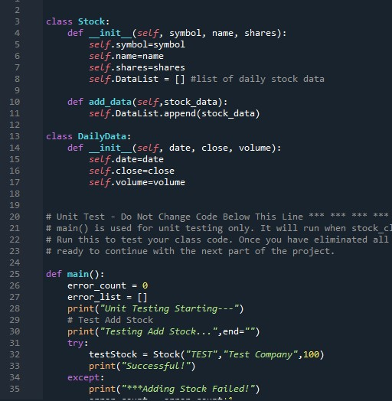
Class Code
Screen Shot of stock_class.py file.

Slide 7
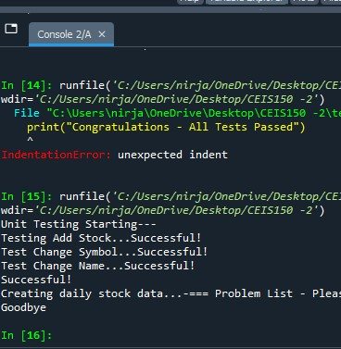
Unit Test
Screen Shot of successful unit test.

Slide 8
Project -111
Text-Based User Interface
Summary Report

Slide 9
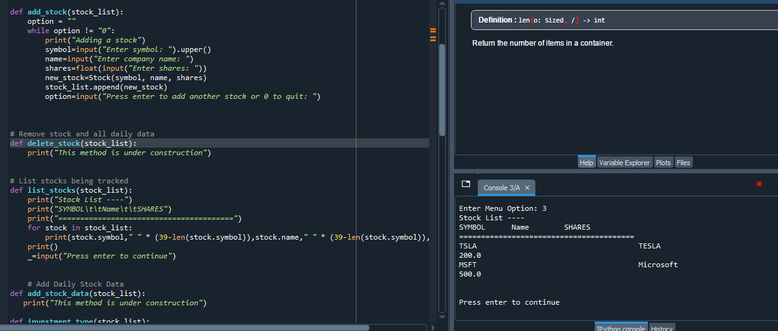
Adding a Stock

Slide 10
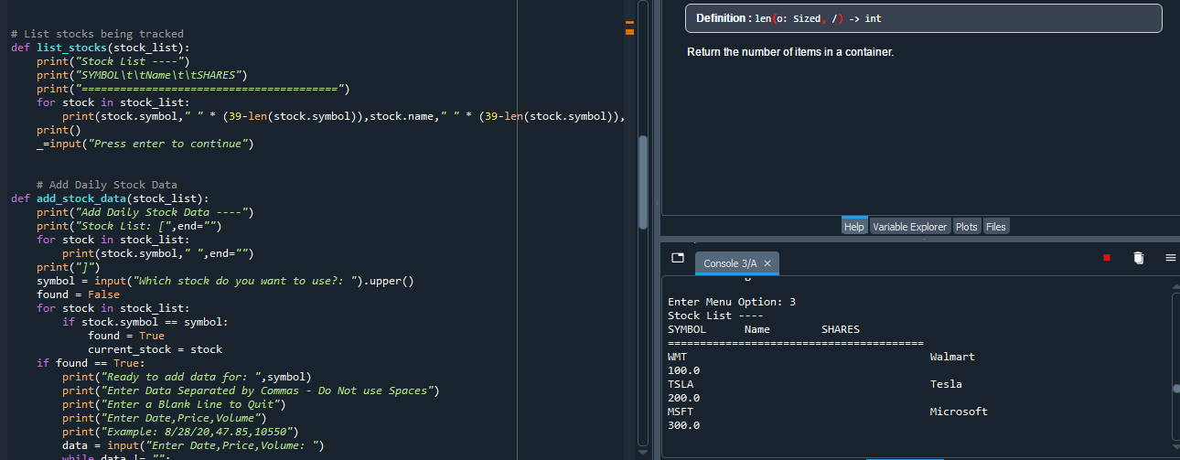
LISTING 3 STOCKS

Slide 11
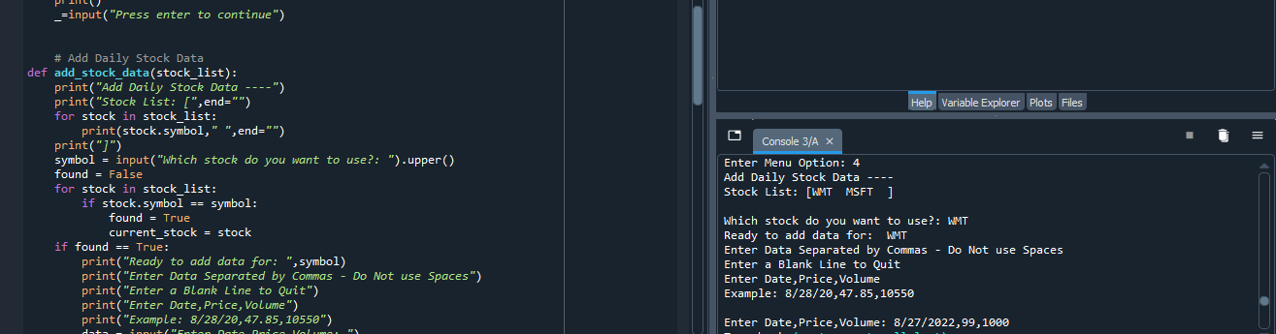
Daily data

Slide 12
Project -IV
Inheritance Summary Report

Slide 13
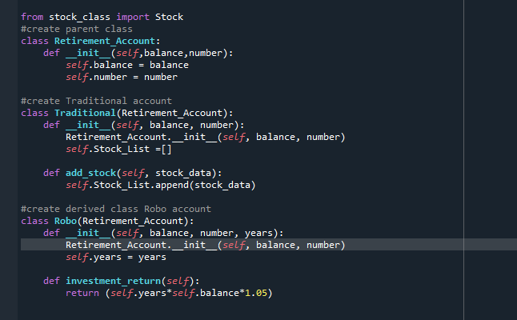
Inherited Classes
Screenshot of the Classes

Slide 14
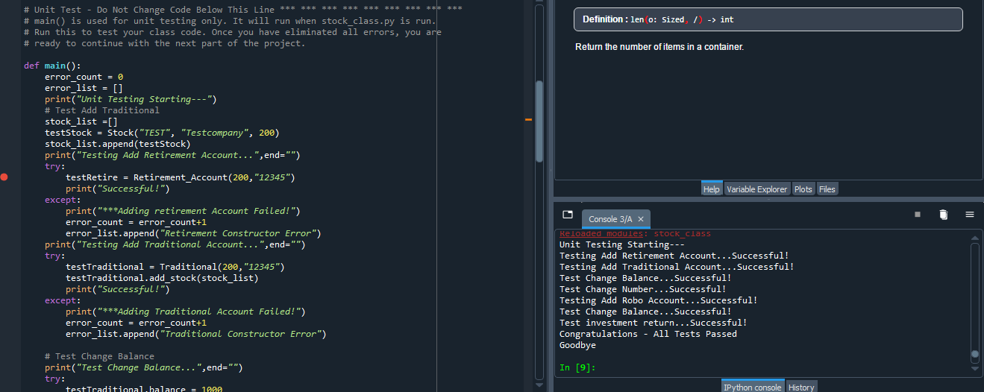
UNIT TESTS
Screenshot of unit tests successfully completed

Slide 15
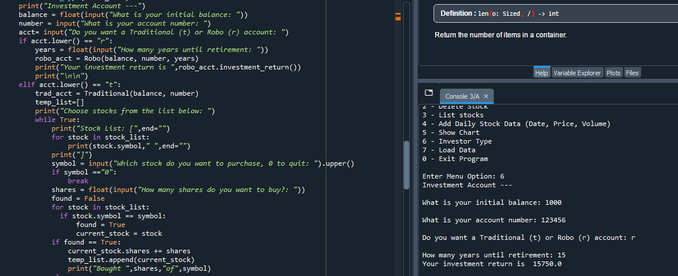
Stock menu program

Slide 16
Project -V
Stock Tracking Project

Slide 17
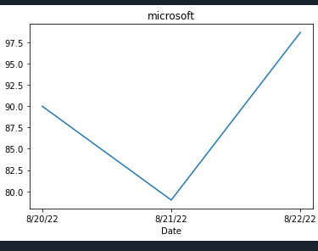
CHART
Created a Successfully working chart

Slide 18
Project –V1
Loading Data

Slide 19
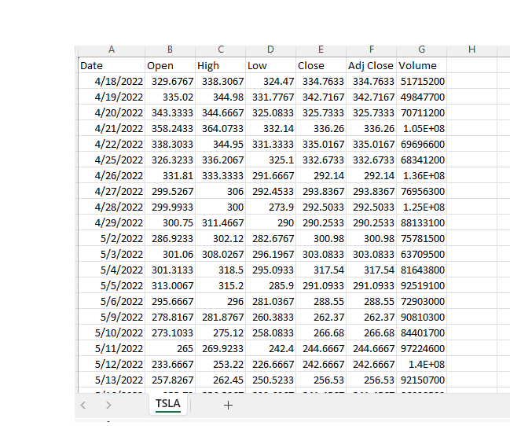
FILE
Screenshot of the file downloaded from Yahoo Finance

Slide 20
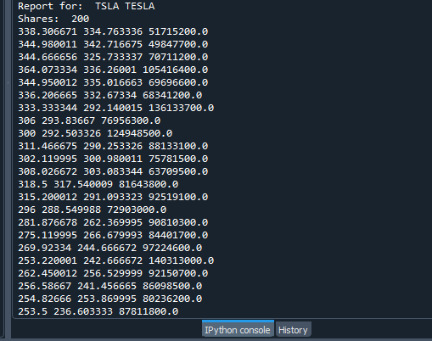
Import Data
Screenshot of the Historical Data Import

Slide 21
Project –V11
GRAPHICAL USER INTERFACE (GUI)

Slide 22
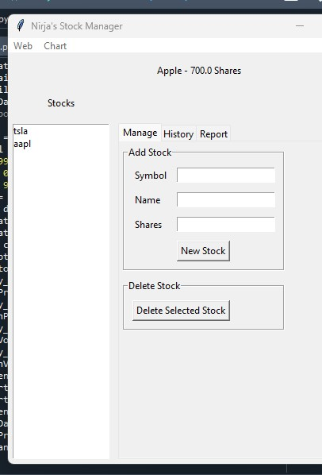
Stocks in GUI
Screenshot of GUI Working

Slide 23
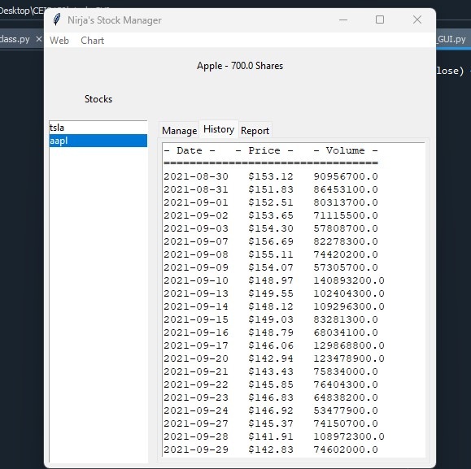
HISTORY TAB
Screenshot of History Tab with Import Data

Slide 24
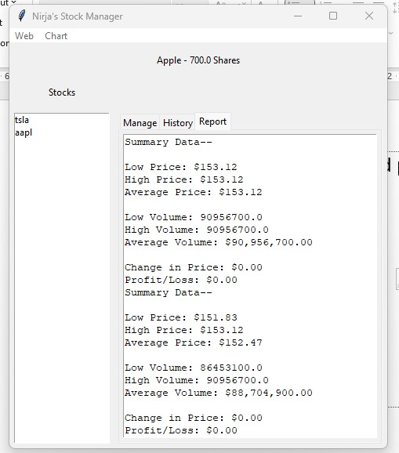
Report Complete
Screenshot of Report Tab

Slide 25
Career Skills
Python is a popular programming and one of the most used programming in the IT industry.
This course involved heavy coding and I learned a lot as I am a newbie to computer programming. I was scared about coding before this course but now I am confident I can do coding.
The skills I developed throughout the course will advance my skills and help me in future courses.
I enjoyed creating all the projects and found out what Python can do.

Slide 26
Conclusion
In short, I learned new skills throughout the course in each module project. I created a tracking project, adding stock, unit tests, adding stock from Yahoo Finance.

